Slide 1
4-21 ARI BRG Meeting: Brief Agenda Items
Bob & Bryan NLP building item data base
Reaction time from Study 1 non-linear results
Liking RT results
Data management updates
Other updates

Slide 2
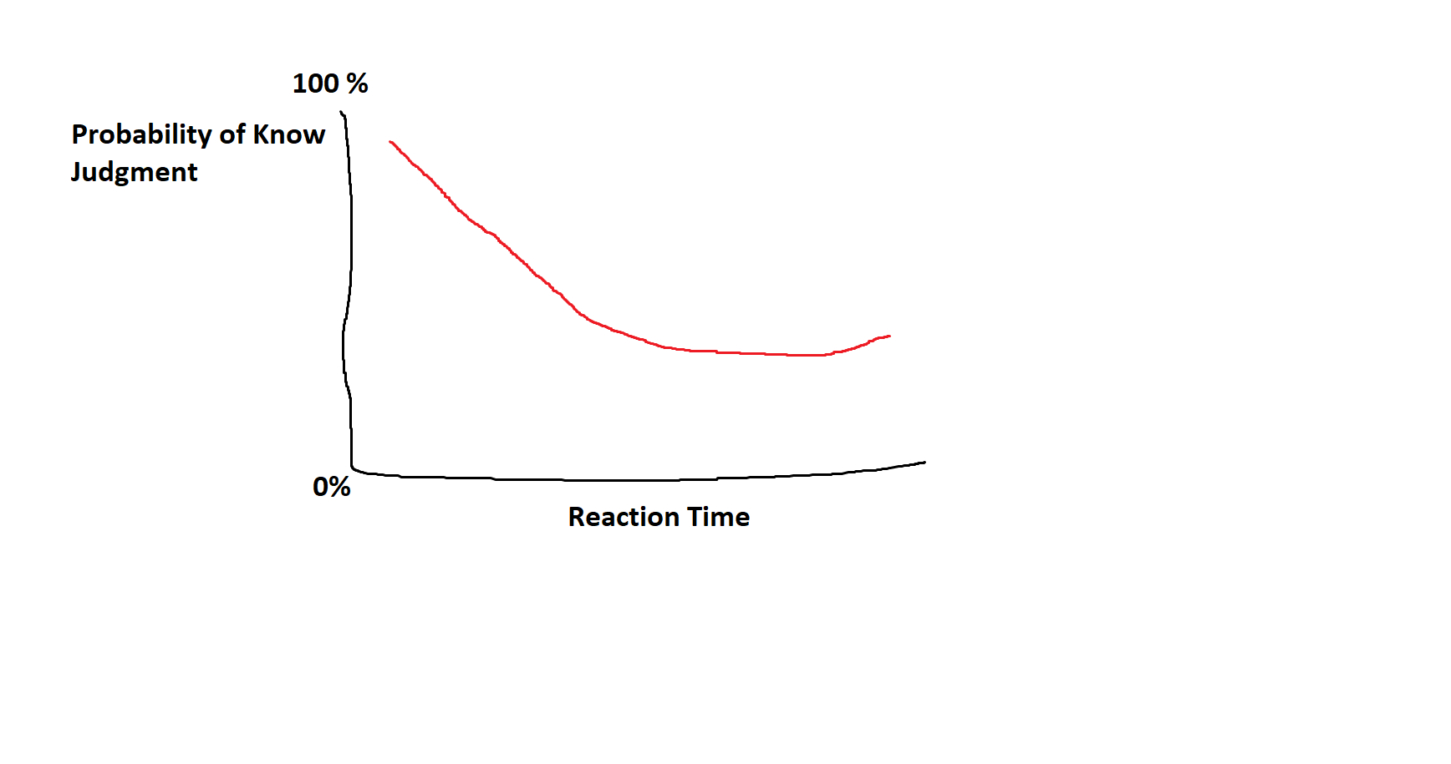
 | Odds of a “Know” Judgment
Predictors | Odds Ratios | CI | p
(Intercept) | 1.56 | 1.23 – 1.97 | <0.001
Reaction time (log) | 0.93 | 0.89 – 0.97 | 0.001
RT * RT | 0.98 | 0.97 – 0.99 | 0.001
Random Effects
σ² | 3.29
τ₀₀ _{ID} | 1.38
τ₀₀ _{scale} | 0.06
ICC | 0.30
N _{ID} | 1401
N _{scale} | 5
Observations | 24420
Marginal R² / Conditional R² | 0.001 / 0.305

